Slide 1
10. From 1x1 to MxM Web App

Slide 2
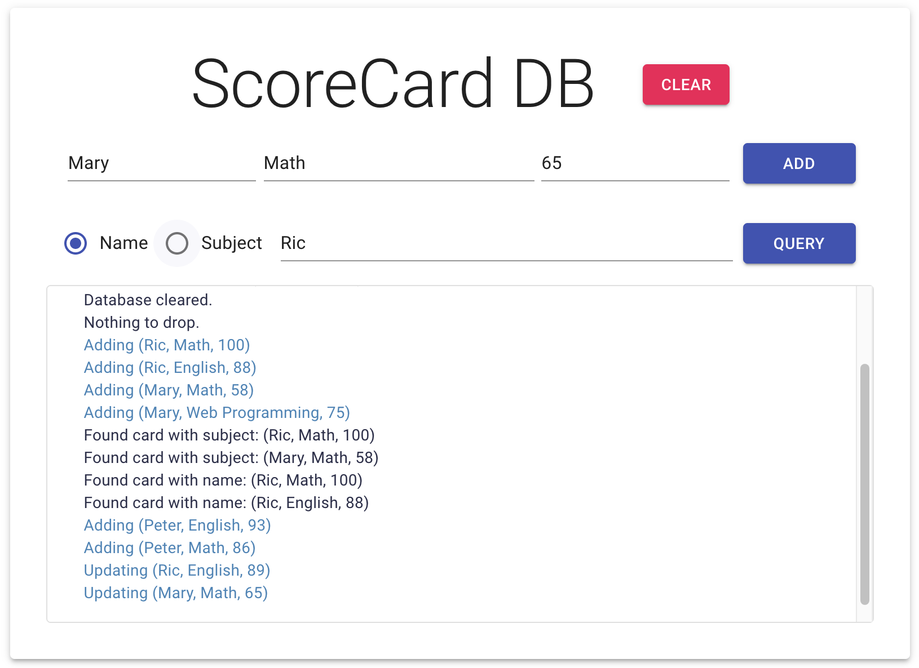
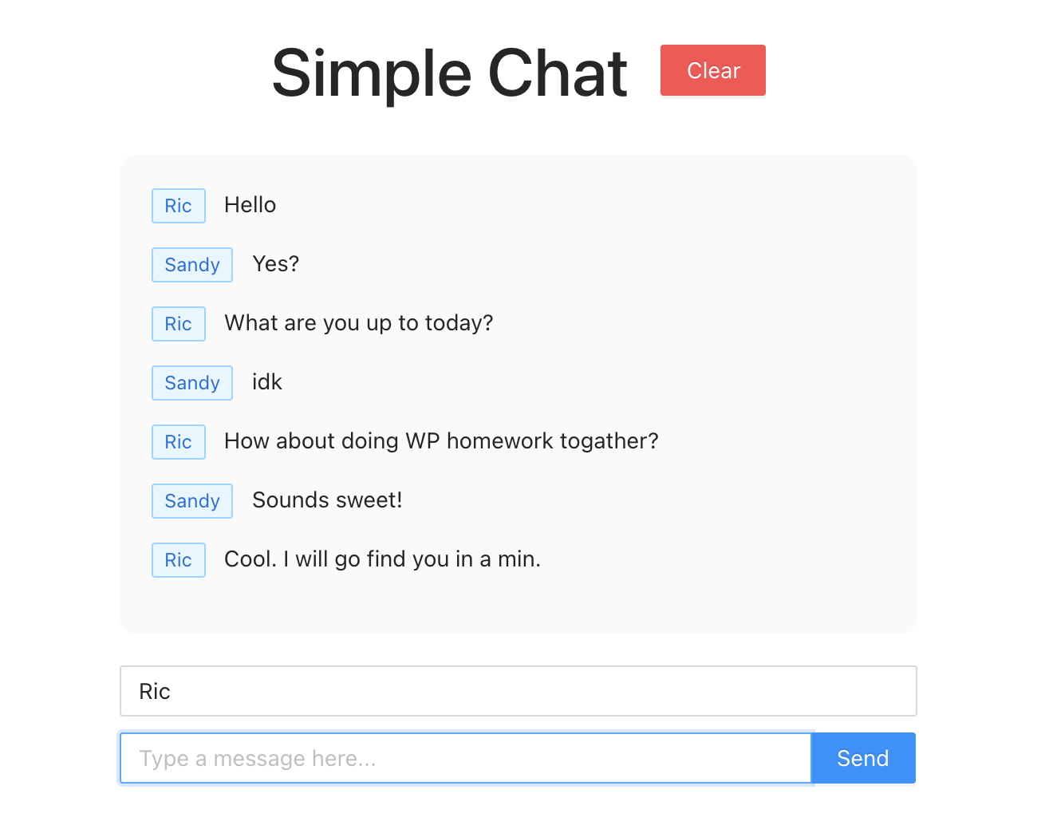
Recap: Full-stack Applications
In HW#6 and Lecture Note #9, 我們示範了利用 React + Axios/WebSocket + Express/Node.js + Mongoose 來建立一個全端的應用
這些應用大抵都是一個 client 對應一個 server, 但在現實中像是 social network, online gaming 等應用，常常會需要 clients 之間多對多互動的應用

Slide 3
From 1x1 to MxM Web Applications
Moving on to multiple-to-multiple-client applications, we are going to cover:
Building a chatroom with multiple socket communication
Subscription and broadcast
Efficient database query with GraphQL
Login mechanism

Slide 4
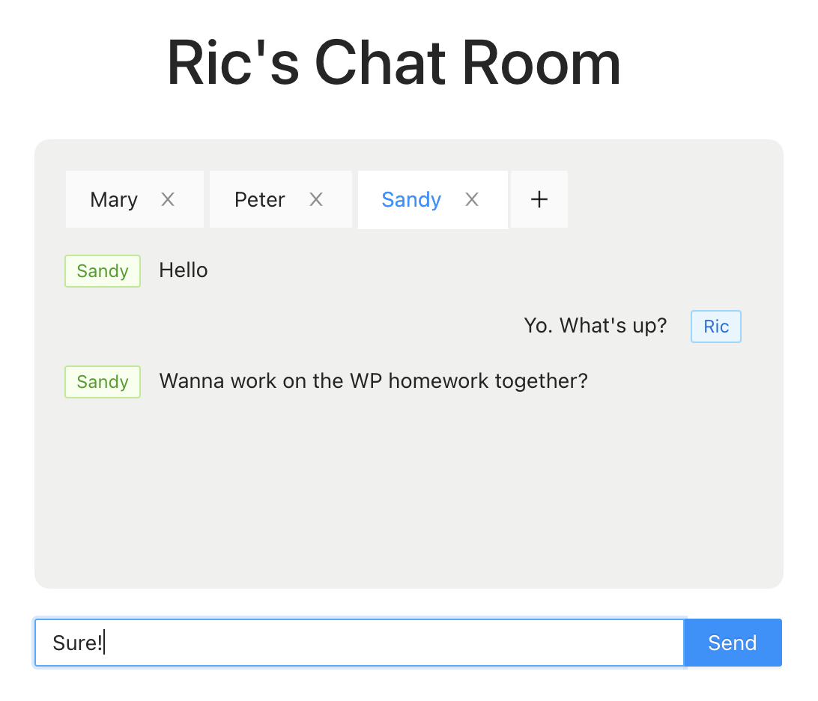
We are going to build a Chatroom app, in which you can chat with your friends on the same server.

Slide 5
Building a Chatroom App
Create a new directory and a new chatroom project
mkdir chatroom_test; cd chatroom_test; yarn init -y
// add "start" and "server" entries to package.json
Frontend
create-react-app frontend
cd frontend; yarn add antd; // install Ant Design
// Add this line to src/index.js import "antd/dist/antd.css";
Backend
mkdir backend; cd backend; yarn init -y
yarn add -D dotenv-defaults express mongoose nodemon ws
// Add these lines to package.json "type": "module", "scripts": { "server": "nodemon server.js" },

Slide 6
Designing a "Chatroom" App
Required Features:
Each user can start a chatroom with a login name (No login/password mechanism for now)
User can create a chatbox and specify a friend to talk to
This chatbox can be closed/re-open at any time
User can switch to another chatbox by clicking on the tab
(Optional) User can clear the chat log from server
The chatbox is showing the chat log in a chronological order (i.e. the latest on the bottom)
As convention, user's message is on the right, while friend's message is on the left
(Optional) When new message arrives, the corresponding chatbox will be signaled, if not active

Slide 7
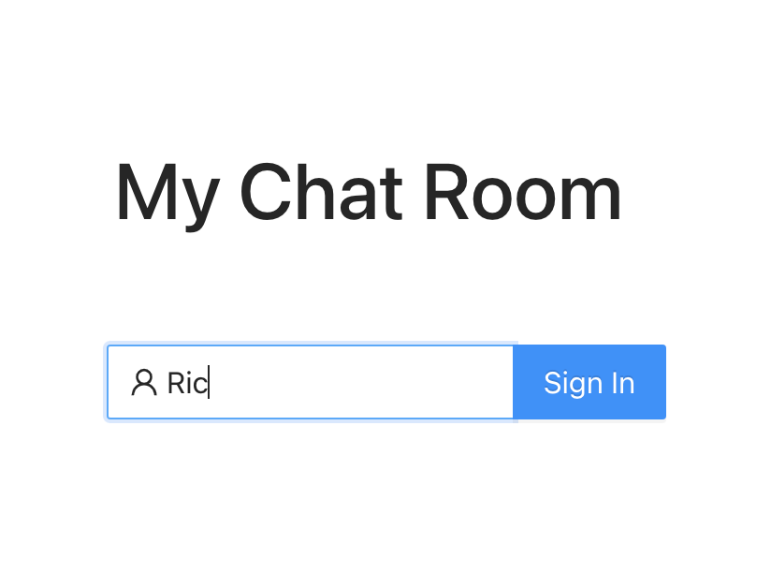
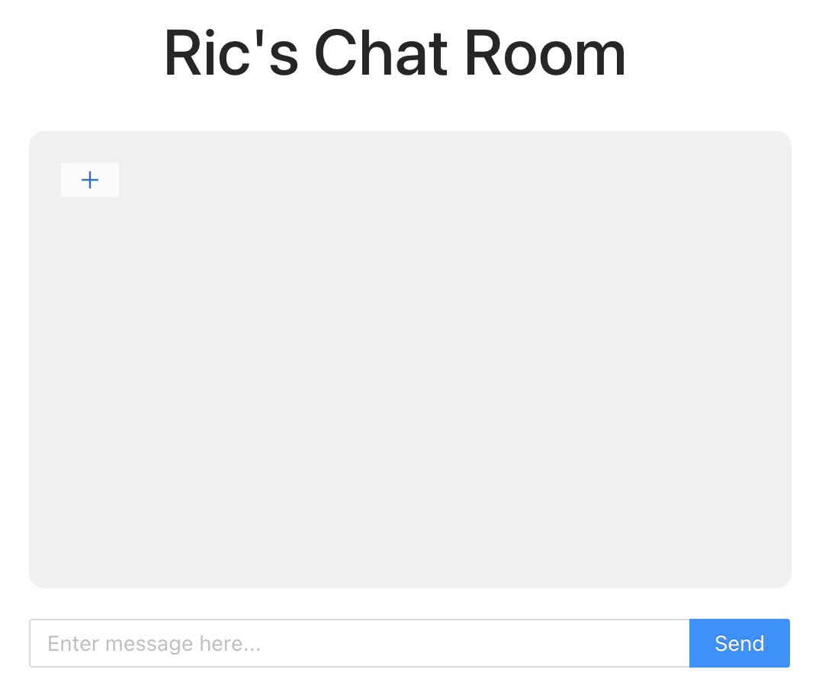
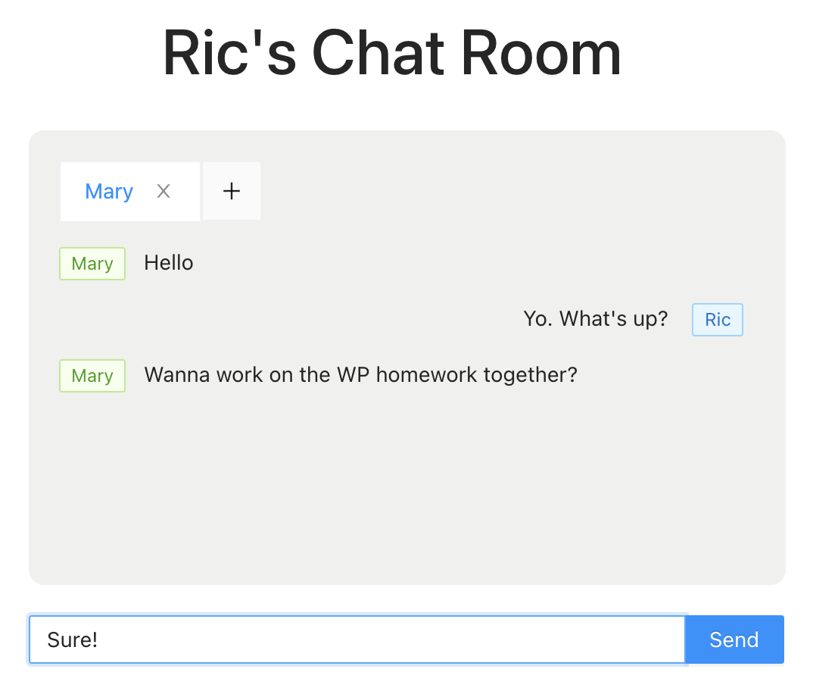
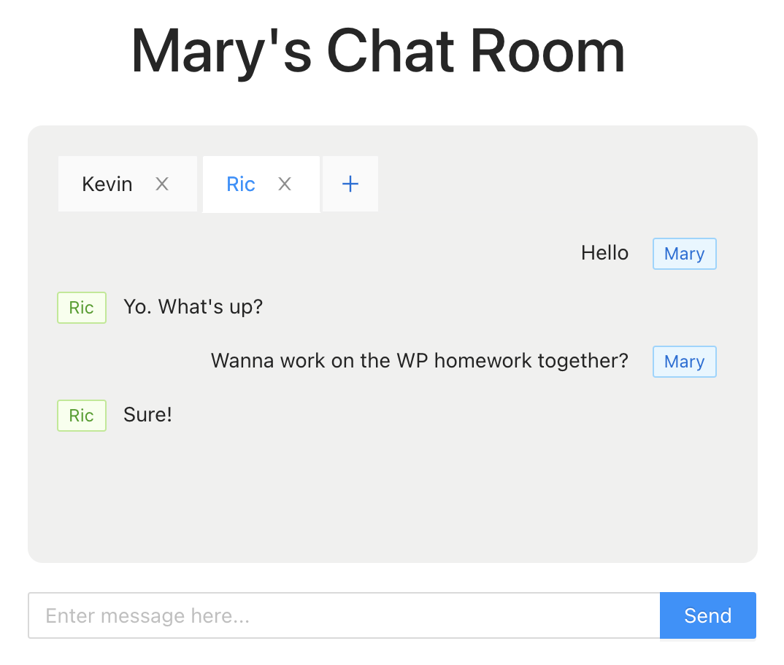
Skeleton Design of the Wireframes
Frontend
me
ws
{ chatBox (me, friend) }
chatLog
{ ws, chatLog}
{ ws’, chatLog’ }
{ chatbox, msg }
setWs(me)
GET chatLog for { chatBox } OR Create a { newChatBox }
Update chatLog for { chatBox }
Return { ChatBox } and also notify { ws’, ChatLog’ }
RemoveChatBox
Backend

Slide 8
Frontend Design。Recall: Thinking in React
Start with a Mock
Breaking the UI into a Component Hierarchy
Build the Static Version in React
Identify the Minimal (but Complete) Representation Of UI State
Identify Where Your State Should Live
Add Inverse Data Flow

Slide 9
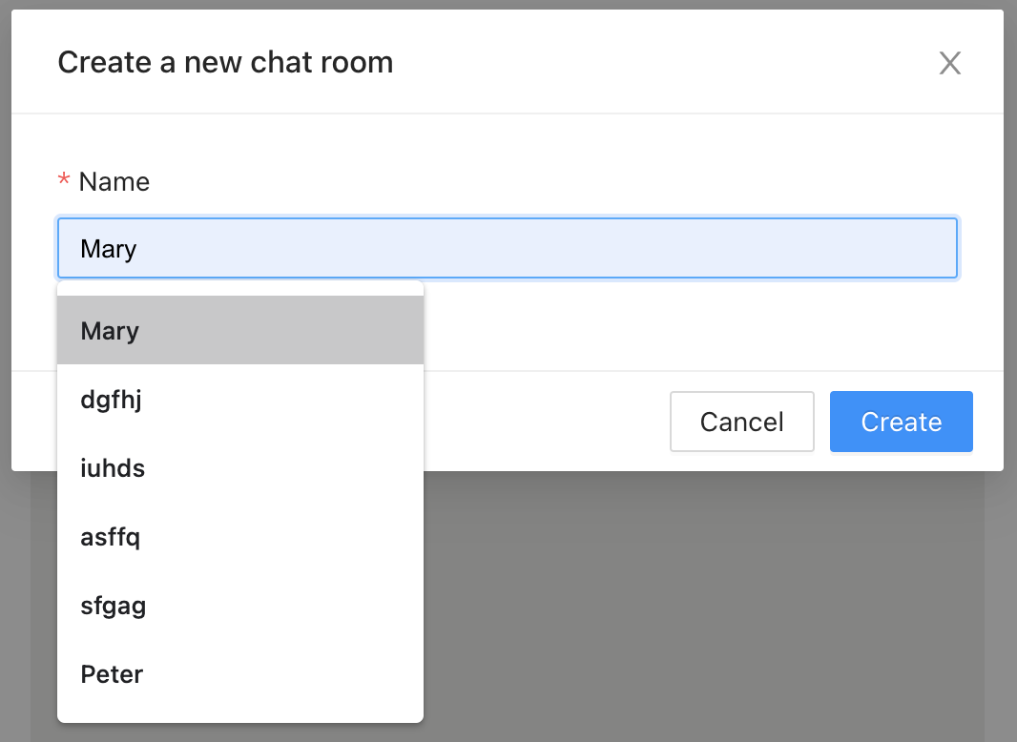
Frontend Design。Recall: Thinking in React
App.js
Has signed in?
Containers/SignIn.js
Containers/ChatRoom.js
Containers/ChatModal.js
Components/ChatBox.js
Components/ChatLog.js

Slide 10
Frontend Design。App.js
先把上個 lecture note 的 App.css 拿過來用 (放在 src 底下)，然後開始改寫 App.js
What are the state variables?
App.js
Has signed in?
{ me, signedIn }
Containers/SignIn.js
Containers/ChatRoom.js
import "./App.css";
import { useState, useEffect } from "react";
const App = () => {
const [signedIn, setSignedIn] = useState(false);
const [me, setMe] = useState("");
return (
<div className="App">
{signedIn? (<ChatRoom />) : (<SignIn />)}
</div>
);
};
export default App;

Slide 11
For "continuous implementation" purpose, 先簡單實現 <SignIn> 與 <ChatRoom> 的畫面

Slide 12
Frontend Design。Containers/SignIn.js
使用 antd 的 <Input.Search> 來實現 <SignIn>
DOM components?
<div className="App-title"> <Input.Search />
Props? (Parameters to <SignIn>)
{ me, setMe, setSignedIn }
Local state variables?
None...

Slide 13
Frontend Design。Containers/SignIn.js
使用 antd 的 <Input.Search> 來實現 <SignIn>
import "../App.css";
import { Input } from "antd";
import { UserOutlined } from "@ant-design/icons";
const SignIn = ({ me, setMe, setSignedIn }) => (
<>
<div className="App-title"><h1>My Chat Room</h1></div>
<Input.Search
prefix={<UserOutlined />}
value={me}
enterButton="Sign In"
onChange={(e) => setMe(e.target.value)}
placeholder="Enter your name"
size="large"
style={{ width: 300, margin: 50 }}
onSearch={() => { setSignedIn(true); }}
></Input.Search>
</>
);
export default SignIn;

Slide 14
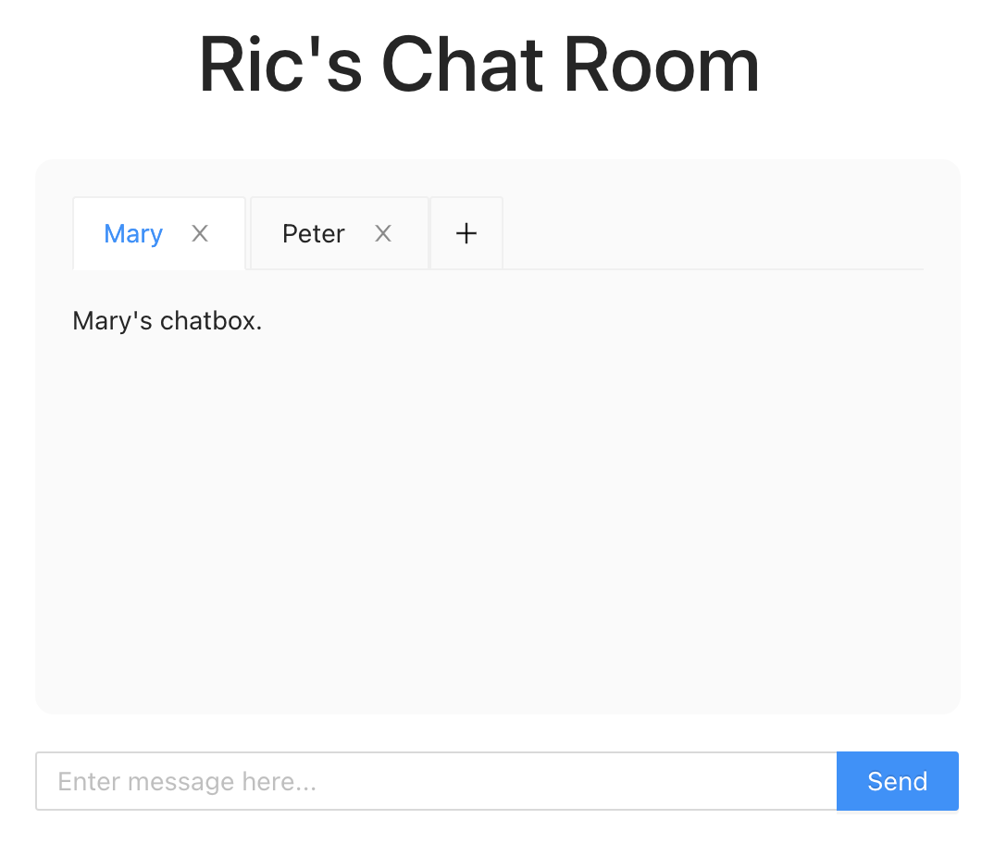
Frontend Design。Containers/ChatRoom.js
使用 antd 的 <Tabs> & <Input.Search> 來實現 <ChatRoom>
DOM components?
<div className="App-title"> <div className="App-messages"> <Tabs type="editable-card" > <TabPane />... <Input.Search />
Props? (Parameters to <ChatRoom>)
{ me }
Local state variables?
chatboxes <= init some data for testing
message

Slide 15
Frontend Design。Containers/ChatRoom.js
使用 antd 的 <Input.Search> 來實現 <ChatRoom>
import "../App.css";
import { useState } from "react";
import { Tabs, Input } from "antd";
const { TabPane } = Tabs;
const ChatRoom = ({ me }) => {
const [chatBoxes, setChatBoxes] = useState([
{ friend: "Mary", key: "MaryChatbox",
chatLog: [] },
{ friend: "Peter", key: "PeterChatBox",
chatLog: [] }
]);
const [messageInput, setMessageInput] =
useState("");
return (
<> <div className="App-title">
<h1>{me}'s Chat Room</h1> </div>
<div className="App-messages">
<Tabs type="editable-card" >
{chatBoxes.map((
{ friend, key, chatLog }) => {
return (
<TabPane tab={friend}
key={key} closable={true}>
<p>{friend}'s chatbox.</p>
</TabPane>
);})}
</Tabs>
</div>
<Input.Search
value={messageInput}
onChange={(e) =>
setMessageInput(e.target.value)}
enterButton="Send"
placeholder=
"Enter message here..."
onSearch={(msg) =>
{ setMessageInput(""); }}
></Input.Search>
</>);
};
export default ChatRoom;

Slide 16
Frontend Design。App.js
App.js
Has signed in?
把 SignedIn 以及 ChatRoom import 進來
Containers/SignIn.js
Containers/ChatRoom.js
import SignIn from './Containers/SignIn'
import ChatRoom from './Containers/ChatRoom'
根據 Containers 的定義，傳入適當的參數
<div className=“App">
{signedIn? (<ChatRoom me={me} />) : (
<SignIn
me={me}
setMe={setMe}
setSignedIn={setSignedIn}
/>)}
</div>

Slide 17
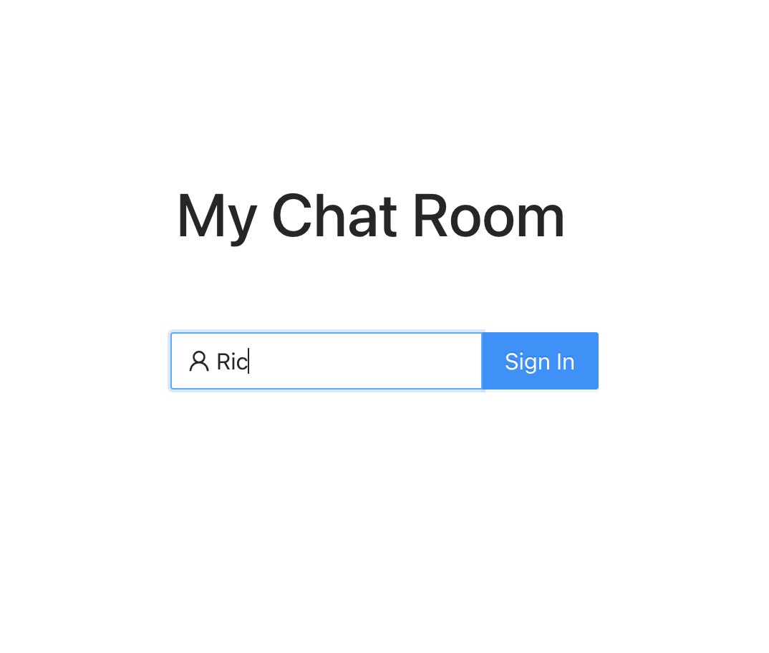
可以 yarn start 看看囉！
在 Sign In box 輸入你的名字後，
你應該會看到畫面的跳轉~

Slide 18
Things to improve for <SignIn>
沒有輸入名字，仍然可以 sign in…
在 <Input.Search> onSearch 時檢查輸入字串是否為空
onSearch={(name) => {
if (!name)
displayStatus({
type: "error",
msg: "Missing user name",
});
else setSignedIn(true);
}}
把上節課 chat app 的 "displayStatus" copy 過來用 (記得把 displayStatus 也傳給 <SignIn>

Slide 19
Things to improve for <SignIn>
Reload 之後不記得我是誰...
使用 local storage (in "App.js")
const LOCALSTORAGE_KEY = "save-me";
const App = () => {
const savedMe = localStorage.getItem(LOCALSTORAGE_KEY);
"me" 的 initial value 先檢查 savedMe
const [me, setMe] = useState(savedMe || "");
在 signedIn 之後把 me 存到 savedMe
useEffect(() => {
if (signedIn) {
localStorage.setItem(LOCALSTORAGE_KEY, me);
}
}, [signedIn]);

Slide 20
Things to improve for <ChatRoom>
目前 chat room <Tabs> 的 '+' 是沒有功用的 => 希望用它來增加 ChatBox
使用 <Tabs> 的 onEdit 功能
<Tabs
type="editable-card"
onEdit={(targetKey, action) => {
if (action === "add") addChatBox();
}}
>
TODO later

Slide 21
Things to improve for <ChatRoom>
新增 ChatBox 時，使用 antd 的 <Modal> (跳出 form) => 新增 "Components/ChatModal.js" 檔案 => 照範例，先做個殼子
import { Modal, Form, Input } from "antd";
const ChatModal = ({ visible, onCreate,
onCancel }) => {
const [form] = Form.useForm();
return (
<Modal
visible={visible}
title="Create a new chat room"
okText="Create" cancelText="Cancel"
onCancel={onCancel}
onOk={() => {
form.validateFields().then((values) => {
form.resetFields();
onCreate(values);
}).catch((e) => { window.alert(e); });
}}>
<Form form={form} layout="vertical"
name="form_in_modal">
<Form.Item
name="name" label="Name"
rules={[{
required: true,
message: "Error: Please enter the name of the person to chat!",
},]}
>
<Input />
</Form.Item>
</Form>
</Modal>
);
};
export default ChatModal;
Cancel
按鈕
ChatRoom 對應的 Cancel 動作 (i.e. 把視窗關掉)
OK
按鈕
ChatRoom 對應的 OK 動作 (i.e. 開新 ChatBoxx)
在 signedIn 之後把 me 存到 savedMe

Slide 22
Things to improve for <ChatRoom>
在 ChatRoom 的 <Tabs> 底下，加上這個 <ChatModal>
設定一個 Bool state var, 控制 Modal 的開關 (visible)
const [modalVisible, setModalVisible] = useState(false);
插入 <ChatModal>
<ChatModal
visible={modalVisible}
onCreate={({ name }) => {
createChatBox(name);
setModalVisible(false);
}}
onCancel={() => {
setModalVisible(false);
}}
/>
ChatModal 按 OK 時的動作
ChatModal 按 Cancel 時的動作
在 signedIn 之後把 me 存到 savedMe

Slide 23
Things to improve for <ChatRoom>
在 ChatRoom 中新增 addChatBox 以及 createChatBox 兩個 functions
addChatBox 就是把 modalVisible 變成 true
const addChatBox = () => { setModalVisible(true); };
createChatBox 就是根據輸入的名字，建立一個 chatBox
const createChatBox = (friend) => {
const newKey = me <= friend ?
`${me}_${friend}` : `${friend}_${me}`;
if (chatBoxes.some(({ key }) => key === newKey)) {
throw new Error(friend +
"'s chat box has already opened.");
}
const newChatBoxes = [...chatBoxes];
const chatLog = [];
newChatBoxes.push({ friend, key: newKey, chatLog });
setChatBoxes(newChatBoxes);
setActiveKey(newKey);
};
在 signedIn 之後把 me 存到 savedMe

Slide 24
Now, yarn start again.
See if you can add a ChatBox!

Slide 25
Things to improve for <ChatRoom>
現在就差 chat room <Tabs> 的 'x' 功用 => 希望用它來移除 ChatBox
在 ChatRoom 中新增一個 activeKey, 來指定目前被點選 (highlighted) chatboxx
const [activeKey, setActiveKey] = useState("")
在 createChatBox() 最後面加上:
setActiveKey(newKey);

Slide 26
Things to improve for <ChatRoom>
在 <Tabs> attribute 加上:
<Tabs
type=“editable-card"
activeKey={activeKey}
onChange={(key) => { setActiveKey(key); }}
比照 addChatBox, 在 <Tabs> 的 onEdit 加上 remove 功能
onEdit={(targetKey, action) => {
if (action === "add") addChatBox();
else if (action === "remove") removeChatBox(targetKey);
}}

Slide 27
Things to improve for <ChatRoom>
實現 removeChatBox function
const removeChatBox = (targetKey) => {
let newActiveKey = activeKey;
let lastIndex;
chatBoxes.forEach(({ key }, i) => {
if (key === targetKey) { lastIndex = i - 1; }});
const newChatBoxes = chatBoxes.filter(
(chatBox) => chatBox.key !== targetKey);
if (newChatBoxes.length) {
if (newActiveKey === targetKey) {
if (lastIndex >= 0) {
newActiveKey = newChatBoxes[lastIndex].key;
} else { newActiveKey = newChatBoxes[0].key; }
}
} else newActiveKey = ""; // No chatBox left
setChatBoxes(newChatBoxes);
setActiveKey(newActiveKey);
};

Slide 28
一切運作正常嗎？
但，你有沒有覺得 ChatRoom.js 越來越長...

Slide 29
Create an "useChatBox" Hook!
目標：把 ChatRoom.js 裡頭兩個較長的 functions "createChatBox" 以及 "removeChatBox" 搬到 hooks/useChatBox.js
Create 一個 hooks 子目錄以及 useChatBox.js 檔案
把 "createChatBox" 以及 "removeChatBox" 搬進去
整體大概長這樣：
import { useState } from "react";
const useChatBox = () => {
const createChatBox = () => { ... };
const removeChatBox = (targetKey, activeKey) => { ... };
return { createChatBox, removeChatBox };
};
export default useChatBox;

Slide 30
Create an "useChatBox" Hook!
有哪些 states 是只有在 useChatBox 才會用到，而在 ChatRoom 用不到？ => 搬到 useChatBox
Ans: chatBoxes
有哪些 states 是在 "createChatBox" 以及 "removeChatBox" 會用到，但只是 READ_ONLY? => 變成 "createChatBox" 以及 "removeChatBox" 的參數
Ans: me, activeKey
有哪些 states 的 setter functions 會在 "createChatBox" 以及 "removeChatBox" 被呼叫到? => 變成 "createChatBox" 以及 "removeChatBox" 的回傳值，讓 caller 去呼叫這個 setter functions
Ans: setActiveKey

Slide 31
有成功嗎？

Slide 32
我們的前端還剩下
message 未處理
Create a "useChat" hook!

Slide 33
Create a useChat hook!
與上次的 chat app 一樣，包含 sendMessage(), 與後端透過 WebSocket 的溝通，都會寫在 useChat hook 裡
先 skip WebSocket 的部分，useChat 的框架如下：
import { useState } from "react";
const useChat = () => {
const [status, setStatus] = useState({}); // { type, msg }
const sendMessage = (payload) => {
console.log(payload);
}; // { key, msg }
return { status, sendMessage };
};
export default useChat;

Slide 34
在 ChatRoom.js 使用 useChat
在 <Input.Search> 的 onSearch 加上底下的 code:
onSearch={(msg) => {
if (!msg) {
displayStatus({
type: "error",
msg: "Please enter message.",
});
return;
} else if (activeKey === "") {
displayStatus({
type: "error",
msg: "Please add a chatbox first.",
});
setMessageInput("");
return;
}
sendMessage({ key: activeKey, body: msg });
setMessageInput("");
}}

Slide 35
That's about frontend!

Slide 36
關於 Backend
由於準備不及，請至 Ceiba 直接下載 backend 的 code

Slide 37
接下來... Homework #7
以上說明完 frontend 以及 backend 後，HW#7 就是把兩者整合起來。

Slide 38
在下次上課前... 請先看過 GraphQL tutorial
GraphQL tutorial 是參考這個 repo： [Ian Huang's Modern GraphQL Tutorial]， 請大家先 git clone 下來，自行先看過，我下次上課再來跟大家進一步講解
應作者要求，請大家喜歡的話就幫忙給個星星哦！

